Slide 1

CALCULATOR AND
TEXT EDITOR USING
HTML AND CSS
TASK - 2

Slide 2

CALCULATOR AND TEXT
EDITOR USING HTML AND
CSS
LMS Username. Name. Batch. 2113a495 Adelin Grace Tanya S. A49

Slide 3
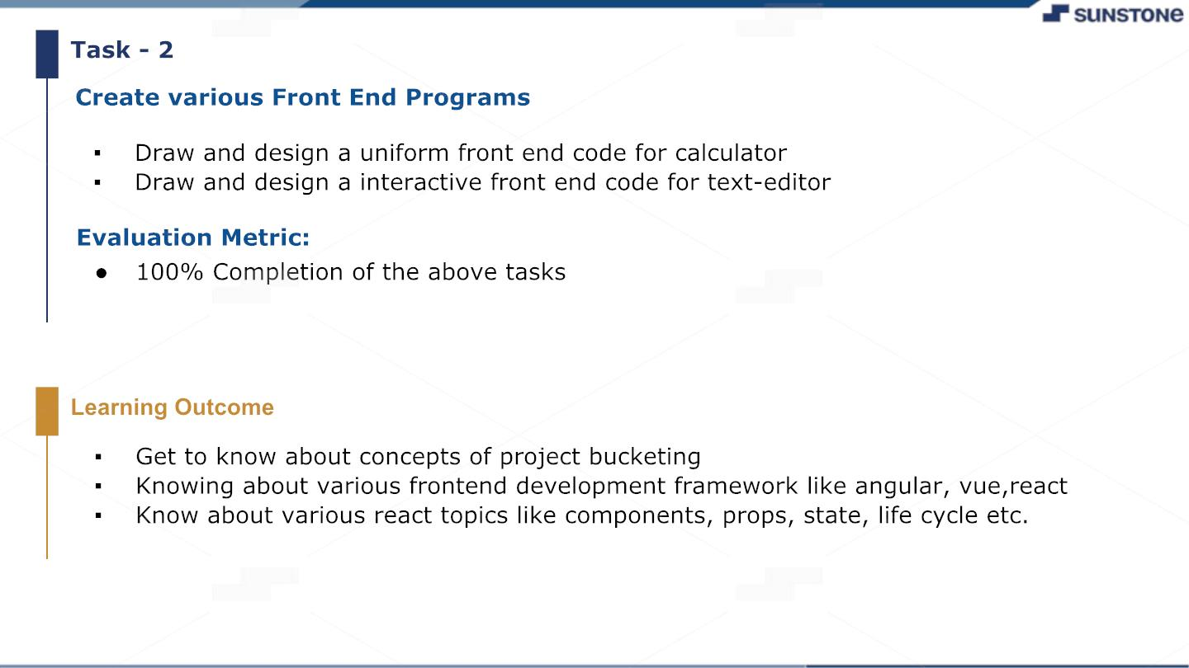

Slide 4

STEP -WISE DESCRIPTION
❖ Define the Purpose
❖ Choose the Programming Language
❖ Plan the Layout
❖ Create HTML Markup
❖ Style with CSS
❖ Add JavaScript Functionality
❖ Test and Debug
❖ Deploy
❖ Maintain and Update
SUMMARY OF YO UR TASK
A CALCULATOR WEBSITE IS A WEBSITE THAT PROVIDES USERS WITH THE ABILITY TO PERFORM
MATHEMATICAL CALCULATIONS AND FUNCTIONS ONLINE. TO CREATE A CALCULATORWEBSITE, THE
PURPOSE MUST BE DEFINED, THE APPROPRIATE PROGRAMMING LANGUAGE AND CMS CHOSEN, AND
A PLAN FOR LAYOUT AND DESIGN MUST BE ESTABLISHED. THE WEBSITE SHOULD BE DEVELOPED
WITH HTML, CSS, AND JAVASCRIPT, THOROUGHLYTESTED AND DEBUGGED, OPTIMIZED FOR SEARCH
ENGINES, AND DEPLOYED SECURELY.REGULAR MAINTENANCE AND UPDATES ARE NECESSARYTO
KEEP THE WEBSITE FUNCTIONAL AND UP TO DATE WITH THE LATESTTECHNOLOGIES.

Slide 5

A.SSESSM ENT PAR AMETE.R
SETUP PROJECT FOR CALCULATOR
PROJECT
SETUP BASIC STRUCTURE
OF TEXT-
EDITOR PROJECT
CREATE A MAIN COMPONENT
WITH THE OUTER
STRUCTURE OF CALCULATOR
Check-List
CREATE MAIN COMPONENT WITH
ALL FEATURE BUTTONS
CREATE A BUTTON COMPONENT
WITH ON CLICK HANDLER
CREATE A JSON OBJECT TO STORE
DATA FOR TEXT EDITOR
CREATE A EVALUATE EXPRESION
FUNCTION TO EVALUATE VALUE
PUSH BOTH CODE TO GITHUB

Slide 6

Submission Github
https://github.com/Adelingrace/NM

Slide 7


